Slide 1
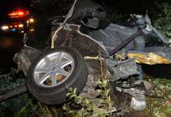

Highway Work Zone Safety Stand Down
Georgia Struck-By Alliance presents
Work Zone Safety:
We’re All in This Together
19th Annual National Work Zone Awareness Week
April 9 – 13, 2018

Slide 2

















Brought to you by
GEORGIA STRUCK-BY ALLIANCE PARTICIPANTS
FHWA Georgia Division

Slide 3
Georgia Struck-By Alliance
We are the faces of distracted driving.
We are mothers, fathers, daughters, sons, sisters, brothers, spouses and friends to those who have died because people chose to take part in phone calls or text messages while driving.

Slide 4
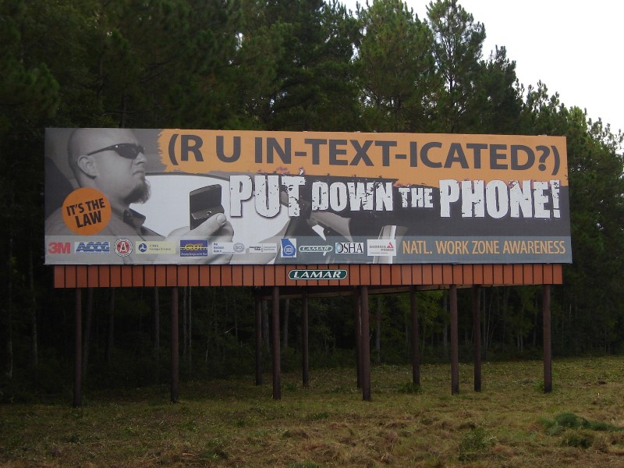

Slide 5
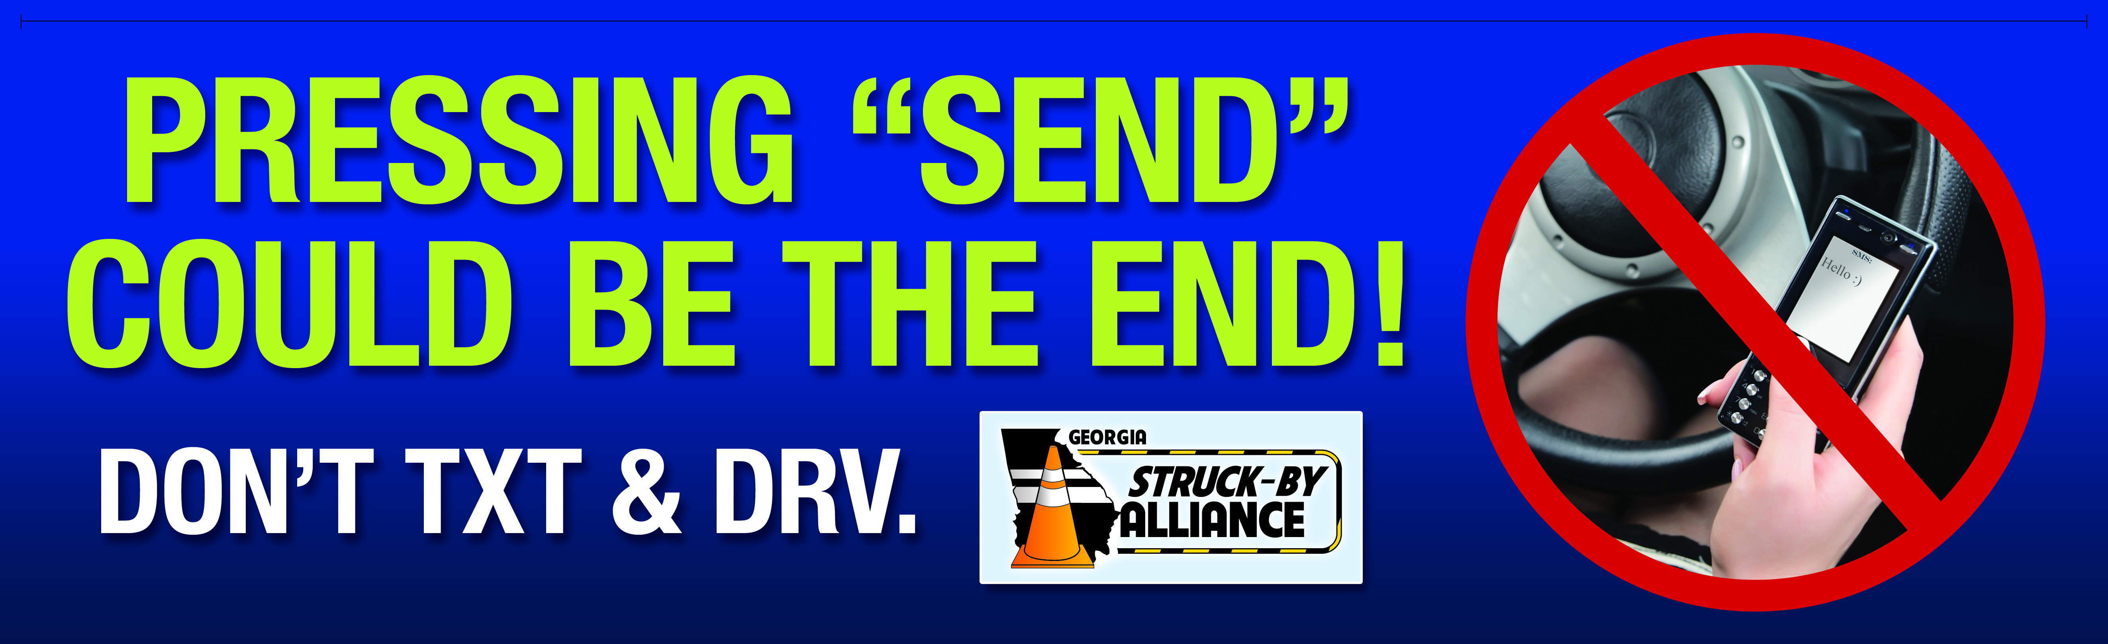
Notes:
Lamar Advertising donated this billboard to the Georgia Struck-by Alliance. It can be seen throughout Georgia in the following cities: Rome, Atlanta, Savannah, Augusta, Brunswick and Macon.

Slide 6

Notes:
Lamar Advertising donated this billboard to the Georgia Struck-by Alliance. It can be seen throughout Georgia in the following cities: Rome, Atlanta, Savannah, Augusta, Brunswick and Macon.

Slide 7
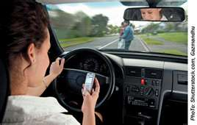
Georgia Struck-By Alliance
Texting While Driving – defined
The act of composing, sending, reading text messages, email or making other similar use of the web on a mobile device while operating a motor vehicle.
Leads to increased distraction behind the wheel.

Slide 8
Georgia Struck-By Alliance
DISTRACTED DRIVING – defined:
A replacement phrase for the more popular terms "texting while driving" and "talking while driving.”
Occurs when a driver has something other than driving on their mind.
Driving becomes subsequent in importance to another activity that is happening inside the car, truck or cycle while the vehicle is in motion.

Slide 9
Georgia Struck-By Alliance
Three main types of distraction:
Visual – taking your eyes off the road
Manual – taking your hands off the wheel
Cognitive – taking your mind off what you are doing
Talking on cell phones and texting behind the wheel both lead to distraction. Driver inattention is the leading cause of accidents.

Slide 10
Georgia Struck-By Alliance
Beware of Distracted Drivers – Stay vigilant and watch for these signs:
Swerving
Taking extreme wide turns
Driving too slowly
Following too closely
Braking erratically

Slide 11
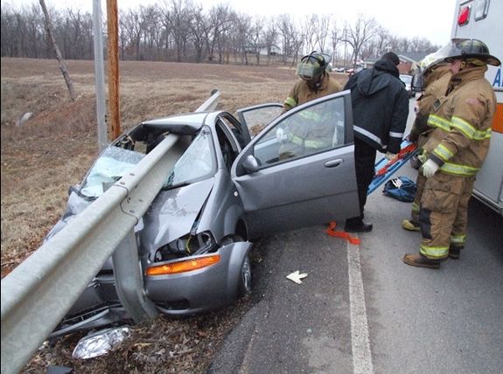
Georgia Struck-By Alliance
Crashes Caused by Distracted Drivers
A crash occurred when a driver operating a trolley car was text messaging his girlfriend injuring 46 people costing an estimated $9.6 million.
Texting was blamed in a train collision which killed 25 passengers.
The engineer of the train had sent 45 text messages while operating
the train.
A young girl was killed in an accident allegedly caused by a truck
driver who crashed into 10 cars when he was sending a text message
while driving.

Slide 12
Georgia Struck-By Alliance
2012 Distracted Driving Statistics
A poll of more than 6,016 American adults revealed that:
A large percentage of people said they know distracted driving is
dangerous, but do it anyway
About 1/3 of drivers (35%) have sent or received text messages
Approximately 73% of drivers often eat or drink
Four percent of adult drivers have read a map, book, newspaper, etc.
Around 20% have combed or styled their hair, shave, put on make up
Approximately 44% have change CDs, DVDs or tapes
About 13% have surfed the Internet
Younger drivers were more likely to engage in distracted driving
Men were more likely to drive while drowsy, after drinking, reach a
map, use a GPS and use the Internet

Slide 13
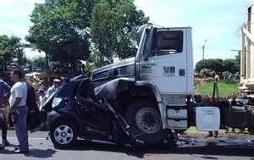
Georgia Struck-By Alliance
The Truth about Texting while Driving:
Of all phone related tasks, texting while driving is the most dangerous.
Teens are four (4) times more likely to get into car crashes or near crash events directly related to talking or texting.
A car driver dialing a cell phone is 2.8 times and a truck driver is 5.9 times more likely to get into a crash.
A driver reaching for a cell phone or other device is 1.4 times more likely to be in a crash.
A truck driver texting is 23.2 times more likely to get into a crash and 6.7 times more likely when reaching for a phone or other device.
For every 6 seconds of drive time, a driver sending or receiving a text message spends 4.6 seconds with their eyes off the road - making texting the most distracting of all cell phone related tasks.

Slide 14
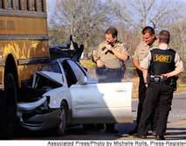
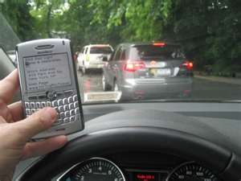
Georgia Struck-By Alliance
Texting While Driving National Statistics:
Approximately 3,179 deaths and nearly 431,000 injuries are caused by distracted drivers every year. (2014)
While teenagers are texting, they spend about 10 percent of the time outside the driving lane they’re supposed to be in .
Talking on a cell phone while driving can make a young driver’s reaction time as slow as that of a 70-year-old.
Answering a text takes away your attention for about five seconds, which is enough time to travel the length of a football field.

Slide 15
Georgia Struck-By Alliance
Why is distracted driving a problem?
Distracted driving crashes killed more than 3,179 people and injured nearly 431,000 in 2014. (DOT)
18 percent of injury crashes in 2014 involved reports of distracted driving. (NHTSA)
Of those killed in distracted-driving-related crashes, 385 involved reports of a cell phone as a distraction (13% of fatalities in distraction-related crashes). (2014 report from NHTSA)

Slide 16
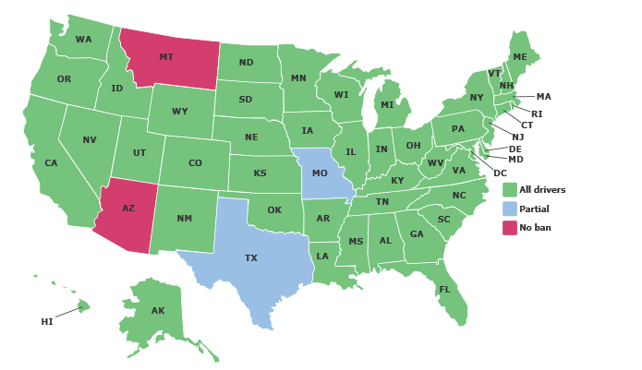
Georgia Struck-By Alliance
Texting while driving statutes in the United States
Text messaging is banned for all drivers in 46 states and the District of
Columbia. In addition, novice drivers are banned from texting in two states
(Missouri and Texas). Updated on December 2015

Slide 17
Georgia Struck-By Alliance
Georgia Statistics
2013 National Highway Traffic Safety Administration data shows that Interstate 285 is one of America’s deadliest freeways. Every 10 miles, I-285 experienced 3.5 fatal crashes, which is 0.5 more than the next-highest freeway (I-4 in Florida).
Notes:
Doug Turnbull’s advice for drivers on I-285: “With this fact in mind, drive with even more awareness on I-285. Think twice before trying to squeeze between two tractor trailers, as you move to exit at the last second. Read the signs and obey the speed limits on those sharp transition ramps on the south side Perimeter. And, please, don’t stray your eyes to your smart device. With all of the aforementioned variables swirling around I-285, you just cannot afford to miss one. That could be the difference in life and death.” Doug Turnbull is the PM drive airborne anchor for Triple Team Traffic on News 95-5 FM and AM-750 WSB and writes how own traffic blog on wsbradio.com.
Number of fatalities on Georgia’s Roadways:
CY 2014: 1,170 fatalities
CY 2015: 1,432 fatalities
CY 2016: 1,536 fatalities
Traffic Fatalities in Georgia provided by GDOT: http://www.dot.ga.gov/DS/SafetyOperation/DAAA
Traffic Fatalities Up in Georgia
As of the six-month mark (ending June 30, 2015) there were a total of 662 fatalities - 114 more than the first half of last year. With an average of over 100 deaths a month, Georgia is on track for 1,200 or more fatalities in 2015. That would be the first increase in nine years!
49% Roadway fatalities in Georgia are single vehicle crashes - hitting a fixed object (tree, culvert, or bridge)

Slide 18
Georgia Struck-By Alliance
GDOT Campaign
“Drive Alert Arrive Alert”
In Georgia, single vehicle crashes account for 49 percent of traffic fatalities and the main cause appears to be distracted driving. Drivers, now more than ever, are driving distracted or impaired. They’re talking on the phone, texting, using GPS or doing a variety of other things. They are not focused on driving.
The GDOT “Drive Alert Arrive Alive” Campaign implores drivers to take responsibility for their driving behavior:
- Buckle up — just 39 percent of fatality victims are identified as wearing seatbelts;
- Stay off the phone and no texting — 74 percent of fatalities are attributed to driver behavior;
- Drive alert — do not drive drowsy or under the influence of drugs or alcohol.
Notes:
Full article: http://www.albanyherald.com/news/russell-r-mcmurry-roadway-deaths-reach-alarming-milestone/article_2f0ef121-00ae-586a-90a4-1cf9bb56d123.html

Slide 19
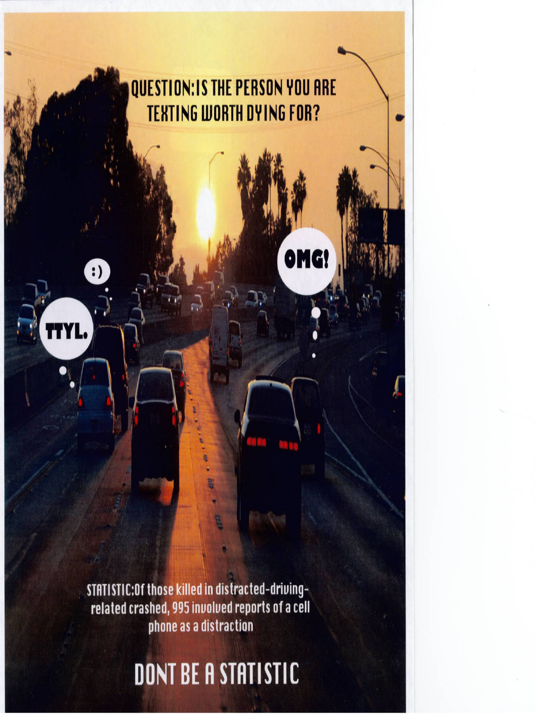
Georgia Struck-By Alliance

Slide 20
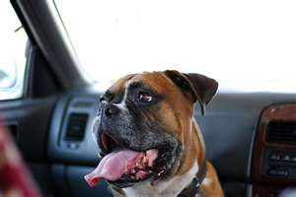
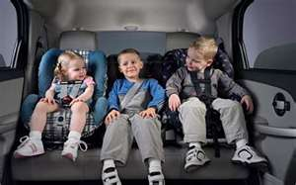
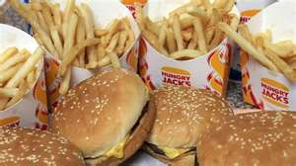
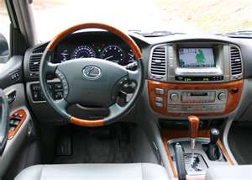
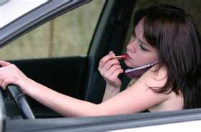
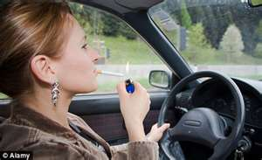
Georgia Struck-By Alliance
Phones don’t get all the blame!
Smartphones take center stage, but they’re not in this alone! Other culprits are:
    In-car technologies
    Food and drinks (Dashboard Dining)
    Children
    Pets
    Grooming
    Smoking
    Rubbernecking
    Singing
cn u jst drV n do Ø Ls?

Slide 21

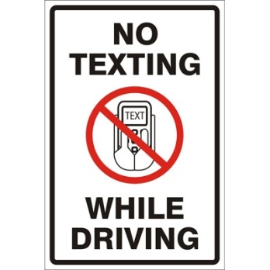
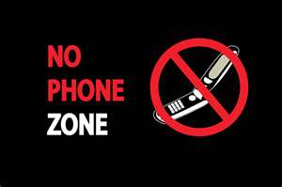
Georgia Struck-By Alliance
Year after year, the leading cause of worker fatalities is motor vehicle crashes.
What YOU can do:
  Work with your employers to:
Lead by example
    Declare work vehicles “text-free zones”
    FOLLOW COMPANY/EMPLOYER POLICIES THAT BAN TEXTING WHILE DRIVING
    Establish work procedures and rules that do not make it necessary to text while driving in order to carry out job duties

Slide 22
Georgia Struck-By Alliance
Work Zone Facts
In 2014, 3,179 people were killed on U.S. roadways and an estimated additional 431,000 were injured in motor vehicle crashes that were reported to have involved distracted driving (FARS and GES).
Of those people killed in distracted-driving-related crashes in 2014, 385 involved reports of a cell phone as a distraction (13% of fatalities in distraction-related crashes).
In 2014, 32,675 people died in motor vehicle traffic crashes in the United States – the lowest number of fatalities since 1949 (30,246 fatalities in 1949).
Approximately 2.338 million people were injured in motor vehicle traffic crashes in 2014, compared to 2.313 million in 2013 according to NHTSA’s National Automotive Sampling System (NASS) & General Estimates System (GES).

Slide 23
Work Zone Facts
Georgia Struck-By Alliance
½ of fatal work zone crashes occur during the day; most on weekdays and most in summer and fall.
More than 20% of the National Highway System is under construction during peak season.
An estimate 12 billion vehicles travel a year through active work zones along roadways.
For thousands of utility and highway work zone employees, the heavily traveled roadways and work zones are their offices.

Slide 24
Georgia Struck-By Alliance
For additional information on distracted driving, these sites are available:
National Institute for Occupational Safety and Health: www.cdc.gov/niosh
National Safety Council: www.nsc.org
U.S. Department of Transportation: www.dot.gov
National Highway Traffic Safety Administration: www.nhtsa.dot.gov
Occupational Safety and Health Administration: www.osha.gov
Focus Driven: www.focusdriven.org

